Slide 1
SOE Roundtable
Ngoc Nguyen.2501
Graduate Advisor for Chapter Services, OSU Sorority & Fraternity Life
Cristina Vega.165
Associate Director for Chapter Services, OSU Sorority & Fraternity Life
Notes:
Vega & Ngoc

Slide 2
Sorority and Fraternity Life
Attendance!
Notes:
Ngoc - https://forms.office.com/r/m0nnyY85YW

Slide 3
Sorority and Fraternity Life
What questions about SOE do you have?
Notes:
Ngoc

Slide 4
Sorority and Fraternity Life
What is SOE?
Standards of Excellence
Developed by SFL Task Force to improve the conditions of the SFL Community
Evolve over time to serve the unique needs of our members while upholding its original goals
Notes:
Ngoc

Slide 5
Sorority and Fraternity Life
What does SOE look like for 2022?
Notes:
Vega

Slide 6
Sorority and Fraternity Life
2/1: Chapter Goals
Member Development, Inclusive Excellence, Academics, Citizenship, Chapter Choice
2/1: Risk Management & Harm Reduction Plan
Social Event Management/Alcohol & Other Drugs, New Member Education/Hazing Prevention, Violence Prevention/Bystander Intervention, Chapter Choice
Both are in your Chapter OneDrive folder
If you don't have editing access, let us know!
Notes:
Vega

Slide 7
Sorority and Fraternity Life
Chapter Officer report philanthropy dollars raised 7 days after event
Individual Monthly SFL Report
At least 5 hours of community service/member each semester
Educational Programming
Member Development
Inclusive Excellence
Risk Management & Harm Reduction
85% Attendance Required for each goal area
Notes:
Ngoc

Slide 8
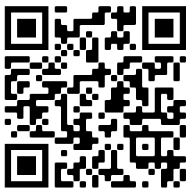
Sorority and Fraternity Life
Chapter Philanthropy Dollars Report
Aim to submit 7 days after event
go.osu.edu/SFLPhilanthropy
Notes:
Ngoc

Slide 9
Sorority and Fraternity Life
Philanthropy vs. Service
Philanthropy: money & products to support a charitable cause
Service: time & efforts to support a charitable cause
Philanthropy Week
Notes:
Vega

Slide 10
Sorority and Fraternity Life
Individual Monthly SFL Report
Due 1st of each month
Open the entire semester via same link
Link will be available in the TWIG & Friday Letter
Important that everyone report their service hours & educational program attendance every month
Reporting helps SFL tell your story & recognize your hard work!
Notes:
Vega

Slide 11
Sorority and Fraternity Life
Let’s Navigate the SFL Report Together!
go.osu.edu/SFL
Notes:
Ngoc

Slide 12
Sorority and Fraternity Life
Educational (Ed) Program?
Notes:
Vega

Slide 13
Sorority and Fraternity Life
Member Development
Professional/career development, leadership
Inclusive Excellence
Focus on diversity, equity, inclusion, social (in)justice
Risk Management & Harm Reduction
Alcohol & other drugs, hazing, mental wellness, sexual assault
85% Ed Program Attendance for each
Can be spread out over multiple programs!
Notes:
Vega

Slide 14
Sorority and Fraternity Life
Hosting an SOE event?
Confused / wondering what counts as SOE & what goal area it falls under? Email me or your Liaison!
Notes:
Ngoc

Slide 15
Sorority and Fraternity Life
Where can you find this info?
go.osu.edu/SFLSOE
Notes:
Ngoc

Slide 16
Sorority and Fraternity Life
Reports From SFL
Snapshot of your chapter’s membership & SOE progress
Monthly, Mid-Semester, & End of Semester
If you need an update on your chapter’s progress before / after these reports, email Ngoc!
Notes:
Vega

Slide 17
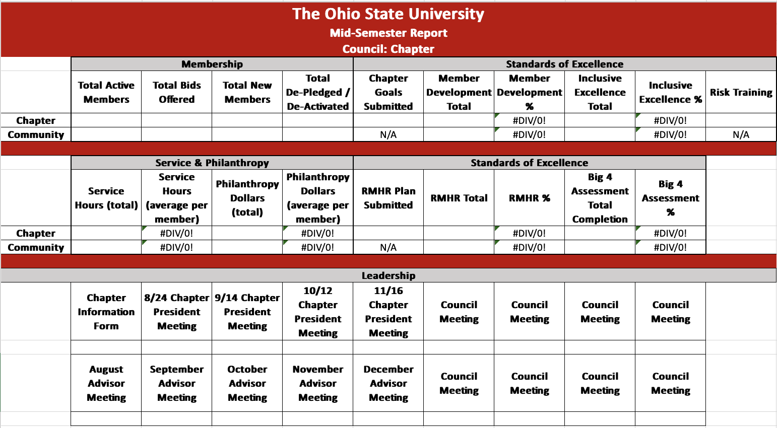
Sorority and Fraternity Life
Report From SFL
Notes:
Vega

Slide 18
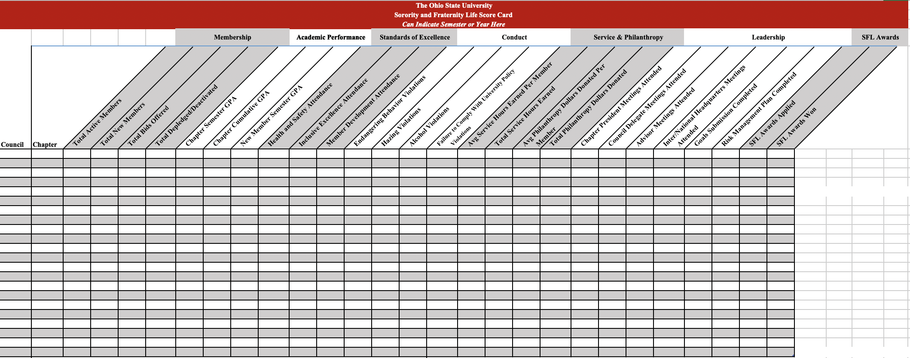
Sorority and Fraternity Life
Scorecard
Notes:
Vega

Slide 19
Sorority and Fraternity Life
Breakouts!
Find existing opportunities for your educational program group!
Member Development
Inclusive Excellence
Risk Management & Harm Reduction
Add opportunities here:
go.osu.edu/soebrainstorm
Notes:
Ngoc

Slide 20
Sorority and Fraternity Life
Looking for opportunities? Visit
go.osu.edu/SFLSpeakerSeries
Notes:
Ngoc

Slide 21
Sorority and Fraternity Life
Program Planning
Identify People: lead, assist in execution
Title, Description, Date, Time, Location
Estimated Attendance
Estimated Cost
What SOE category?
Educational or community building?
If Educational, Learning Outcomes?
Register Event on SFL website
Notes:
Vega

Slide 22
Sorority and Fraternity Life
Nominate Emerging Leaders for BGLI
Notes:
Ngoc - https://forms.office.com/r/k6qND0iuMp

Slide 23
Sorority and Fraternity Life
Questions?
Notes:
Ngoc

